Slide 1
Morph and Worph
Stick up

Slide 2
Stick up

Slide 3
Morph is sleepy

Slide 4
Goodnight

Slide 5
Goodnight Morph

Slide 6
Worph has found some sticky putty

Slide 7
Worph has found some sticky putty

Slide 8
Worph has found some sticky putty

Slide 9
Worph wants to play a trick on Morph

Slide 10
Worph has stuck everything to the wall!

Slide 11
Worph has stuck everything to the wall!

Slide 12
It’s time for Morph to wake up

Slide 13
It’s time for Morph to wake up

Slide 14
It’s time for Morph to wake up

Slide 15
He brushes his teeth

Slide 16
Everything falls down

Slide 17
Everything falls down

Slide 18
Good morning Worph

Slide 19
What?

Slide 20
Morph is walking on the wall

Slide 21
Morph is walking on the wall

Slide 22
Oh no!

Slide 23
Worph has been squashed!

Slide 24
Hiccups

Slide 25
Morph has the hiccups

Slide 26
Morph has the hiccups

Slide 27
Every time he hiccups, he changes shape

Slide 28
Every time he hiccups, he changes shape

Slide 29
Every time he hiccups, he changes shape

Slide 30
Every time he hiccups, he changes shape

Slide 31
Worph tries to help him…

Slide 32
…by blowing a horn!

Slide 33
I’m better!

Slide 34
I’m better!

Slide 35
Morph isn’t better

Slide 36
Hold your breath

Slide 37
One

Slide 38
Two

Slide 39
Three

Slide 40
Four

Slide 41
Five

Slide 42
Six

Slide 43
Seven

Slide 44
Eight

Slide 45
Nine

Slide 46
Ten

Slide 47
Eleven

Slide 48
Twelve

Slide 49
Where has he gone?

Slide 50
Oh no!

Slide 51
Morph fell on Worph

Slide 52
Morph fell on Worph

Slide 53
I’m cured!

Slide 54
My hiccups are better

Slide 55
Bye Morph

Slide 56
Now Worph has the hiccups

Slide 57
Now Worph has the hiccups

Slide 58
Now Worph has the hiccups

Slide 59
Box of tricks

Slide 60
Morph is a magician

Slide 61
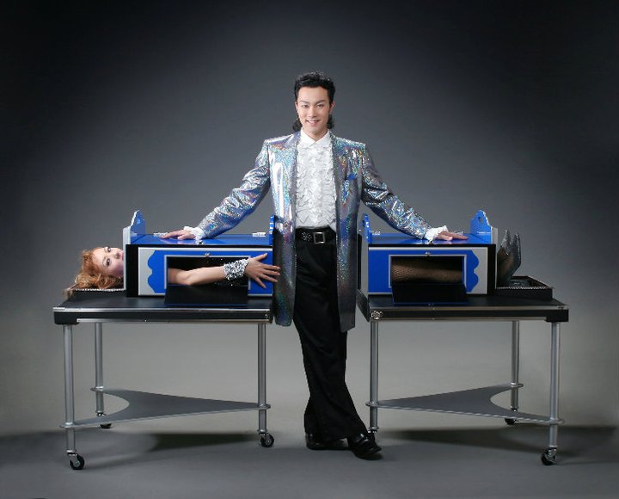

Slide 62
He is pretending to saw Worph in half

Slide 63
He is pretending to saw Worph in half

Slide 64
Ta-da!

Slide 65
Look!

Slide 66
Look!

Slide 67
Magic!

Slide 68
Ta-da!

Slide 69
Worph is fine!

Slide 70
Thank you

Slide 71
High five

Slide 72
Oh no! Morph’s legs have walked away!

Slide 73
Worph thinks it’s very funny!

Slide 74
Come here!

Slide 75
Come here!

Slide 76
Come here!

Slide 77
Worph fixes Morph

Slide 78
Worph fixes Morph

Slide 79
Thank you

Slide 80
Oh no! Morph is the wrong way round!

Slide 81
Oh no! Morph is the wrong way round!

